Slide 1
R5.6 Measurements
Change Summary

Slide 2
Content for R5.6 MHB Point Release
Revised Sections 4.2.5, 4.2.6, and 5.1.2 to remove reporting of data during the retirement phase of life cycle
Product and Service Category Tables update

Slide 3
MHB / PCT 5.6 Release Milestones
Product Exclusion Changes (4.2.5-2.6) - Approved 4/18/2018
Product Category Table (PCT) Changes for 5.6 - Approved 9/19/2018
Final Delivery of Any Additional Content 12/31/2018
Develop MHB 5.6 Point Release (PR) & 5.6 PCT Draft 12/31/2018
Create Scrub Sub-Team 2/1/2019
Issue Draft to IGQ ahead of February Meeting 2/13/2019
Approval for TIA-BPC Review of PR & PCT 2/20/2019
Submit PR & PCT for TIA-BPC Comment Review 2/27/2019
TIA-BPC PR & PCT Comment Review Ends (was 3/12) 3/15/2019
Results of PR & PCT TIA-BPC Comment Review 3/20/2019
Implement Any Corrections for PR & PCT 3/20/2019
Vote by IGQ to Initiate the Vote for TIA-BPC 3/20/2019
Vote by TIA-BPC to Approve PR & PCT for Release Ends 5/01/2019
Submit PR & PCT for Publishing 5/01/2019
Publish the PR & PCT 5/14/2019
Issue the PR & PCT Alert 5/14/2019
Effective Date of PR & PCT 6/30/2019
Mandatory Adoption of PR & PCT 12/31/2019

Slide 4
Revision Process

Slide 5
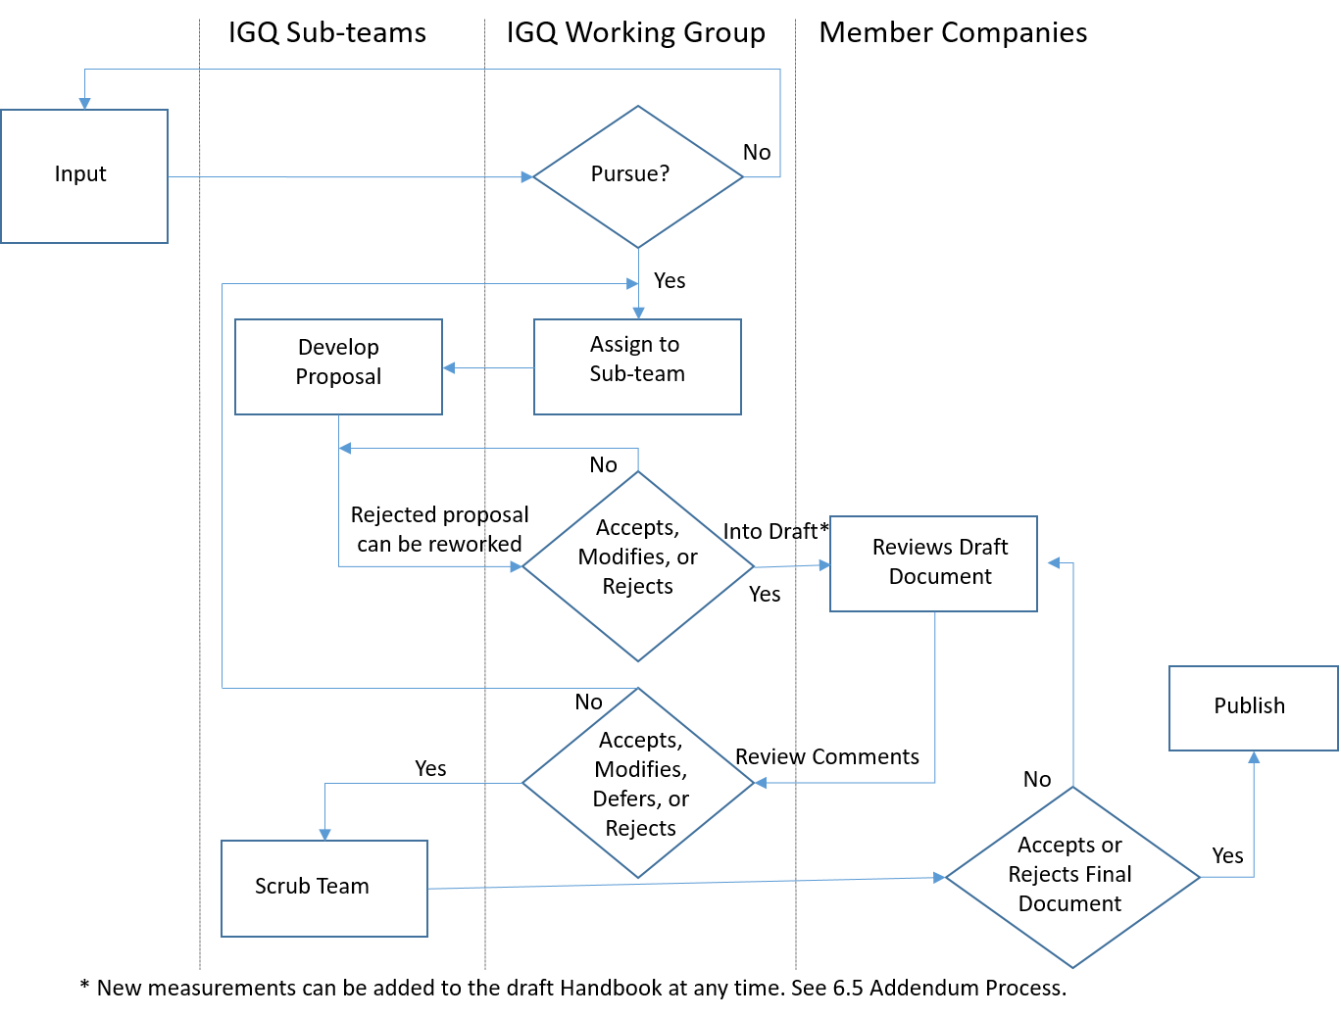
Handbook Production Process BPCP-031
Member Companies &
TL 9000 Users
Solicited
Web
Training
Questions
SMEs
Standing sub-teams
Initiatives/Streams
Not all may be used
for a point release

Slide 6
Why are sub-teams important?
Sub-teams are where
new ideas are developed…
6

Slide 7
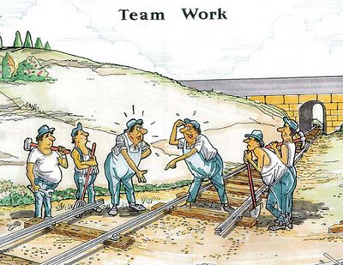
Contributing Sub-teams
PDR Evaluation
MHB R5.6
Product & Service Categories
7

Slide 8
Why Join a Sub-team?
Sub-teams:
Are where ideas are turned into reality
Are key to enhancing TL 9000 and the Forum
Meet “virtually” and don’t require travel
Great opportunities for sharing, learning, and networking
Provide leadership opportunities
Support professional growth
Support requirements for individual TL certification
Provide recognition
Thank-you to the many who participated in IGQ and Oversight Workgroups
and sub-teams to make TL 9000 Measurements Point Release 5.6 possible!
8

Slide 9
Changes

Slide 10
Description of Handbook change
Stops the reporting of data for products in the retirement phase of their life cycle.
  Modified text in sections 4.2.5 and 4.2.6
  Modified Figure 4.2.6-1 Product Life Cycle and TL 9000 Data Submission
  Modified text in section 5.1.2
The reason for this change is it was found that products where no new software features are being developed were impacting the NPR, FRT, and OFR data in a number of categories. This is due to the low number of problem reports associated with such products.

Slide 11
Section 4.2.5 with changes marked
4.2.5 Product and Service Exclusions
The organization may shall exclude data for products that are no longer fully supported for its general customer base. This exclusion shall apply only after formal notification has been made to the customers. This includes any product or service Formal notification of placement of the product, including generic or specific software releases, on Additions and Maintenance (A&M), Manufacturing Discontinued (MD) status, New Service Supply Discontinued Status, End of Support (EOS), or End of Life (EOL) and/or formal notification of cessation of support for the product (End of Life) shall have been made to customers for this exclusion to apply.
For software related products or services, the exclusion applies to generic releases as well as specific software releases. It also applies to any software product where new software feature releases are not deployed.
This exclusion does not apply to individual Ffield Rreplaceable Uunits that have been made obsolete by a later version unless those units are completely recalled from the field.

Slide 12
Section 4.2.5 with changes accepted
4.2.5 Product and Service Exclusions
The organization shall exclude data for products that are no longer fully supported for its general customer base. This exclusion shall apply only after formal notification has been made to the customers. This includes any product or service on Additions and Maintenance (A&M), Manufacturing Discontinued (MD) status, New Service Supply Discontinued Status, End of Support (EOS), or End of Life (EOL).
For software related products or services, the exclusion applies to generic releases as well as specific software releases. It also applies to any software product where new software feature releases are not deployed.
This exclusion does not apply to Field Replaceable Units that have been made obsolete by a later version unless those units are completely recalled from the field.

Slide 13
Section 4.2.6 with changes marked
4.2.6 Product Measurement
Unless otherwise stated, measurements shall apply to products only during the General Availability Phase and Retirement Phases of their life cycle. The terms General Availability Phase and Retirement Phase are defined in the glossary. To assist in a common understanding of a product’s life cycle, see Figure 4.2.6-1.
The organization shall retain the capability to report all applicable TL 9000 measurements during the product’s or service’s Retirement Phase.

Slide 14
Section 4.2.6 with changes accepted
4.2.6 Product Measurement
Unless otherwise stated, measurements shall apply to products only during the General Availability Phase of their life cycle. The terms General Availability Phase and Retirement Phase are defined in the glossary. To assist in a common understanding of a product’s life cycle, see Figure 4.2.6-1.
The organization shall retain the capability to report all applicable TL 9000 measurements during the product’s or service’s Retirement Phase.

Slide 15
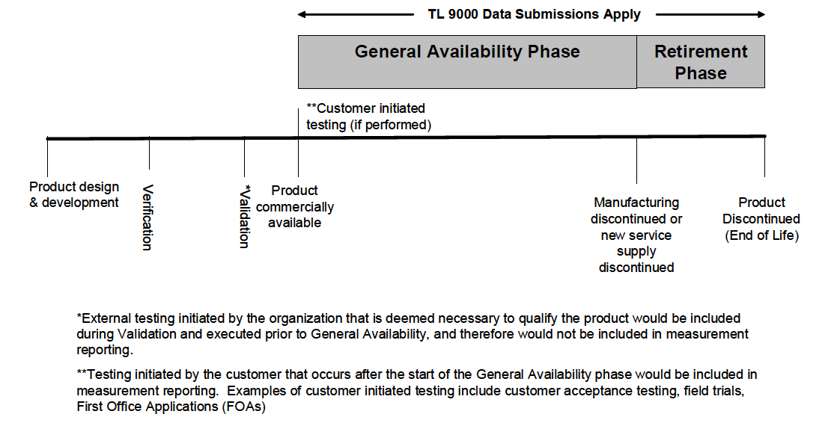
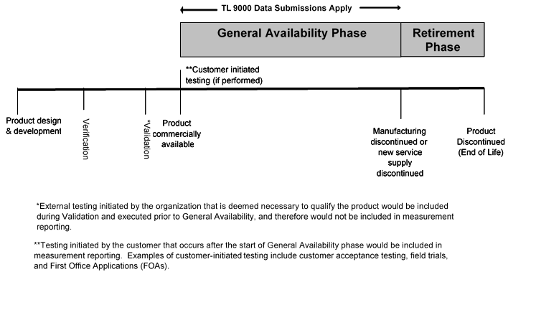
Figure 4.2.6-1 Product Life Cycle and TL 9000 Data Submission with changes marked
Figure in MHB R5.0
Figure in MHB PR R5.6

Slide 16
Section 5.1.2 with changes marked
5.1.2 Purpose
This measurement is used to evaluate the number of customer-originated problem reports related to the product and its associated processes during its General Availability (GA) Phase and Retirement Phases. Problem reports may have a negative impact on the organization (such as rework), on the customer (such as scheduling repeat site visits) and may jeopardize or affect the customer's business operations. Problem reports contribute to loss of end-user loyalty and customer satisfaction. This measurement is intended to stimulate continuous improvements resulting in a reduction of the number of problem reports, associated costs and potential revenue losses.

Slide 17
Product and Service Category Tables
A new edition of the Product and Service Category Tables is being published in conjunction with the R5.6 Point Release. These changes included:
  Combined 3.2.6.2 Analog Video Transmission Equipment and 3.2.6.3 Digital Video Transmission Equipment into a single category, 3.2.6.2 Video Transmission Equipment
  Added 3.3.2.6 5G BTS
  Split 7.1.1 Installation into 7.1.1.1 Physical Installation and 7.1.1.2 Remote Installation
  Changed 8.1.4 Title and definition from “Electromechanical” to “Mechanical and Electromechanical” and added examples of mechanical devices
  Modified definition for 8.2, 8.2.1,8.2,2, 8.2.3, and 8.2.4 from “components” to “electrical components”
  Modified total and partial outage definition for 1.2.3 Media Gateways, 1.2.7 Application Server, and 1.2.8 Service and Network Controller, reducing the 15 seconds minimum to 5 seconds where applicable
  Added HSS outage definitions in addition to HLR definitions in 2.3 Home Location Register (HLR)

Slide 18
Point Release Certification
Rules

Slide 19
Point Release Certification Rules
Measurements Handbook
Primary concerns are to minimize impact on monthly PDR data and derive benefit from changes/additions as soon as feasible
  Set as short as practical
  Likely longer interval when adding a new measurement
  Shorter interval where a change is made to a measurement if the previous data cannot be easily converted
Must have a specific effectivity noting when first month data submissions are allowed and month when submissions are required
All point releases must be complied with at the compliance interval date
The interval should not be more than 6 months

Slide 20
Point Release Certification Rules
Requirements Handbook
New certifications
  Must use most current major release
  Voluntarily may certify to most current point releases
Existing certifications
  Point releases are not required for implementation until the next major release
  Organizations may be certified against a point release voluntarily
Point releases may be required by customers at any time after release

Slide 21
Point Release Publication and Pricing

Slide 22
Point Release Publication
Changed/new sections available as free download from tl9000.org (same as Product and Service Category Tables)
Incorporated in electronic versions for new sales
Previous release will remain available as long as certification to that release is still valid

